Slide 1

Project
Review Classification Using Yelp Dataset
Video Link : https://youtu.be/G8HJPzrg5hI
Bhavana Kurra
Praveen Vatambeti
Vijayasimha Bheemireddy
Navya Mogili
Hello!

Slide 2
Introduction
Introduction:
User reviews are an integral part of web services like TripAdvisor, Amazon, and Yelp, where users can post their opinions about businesses, products and services through reviews consisting of free-form text and a numeric star rating, usually out of 5. These online reviews function as the “online word-of-mouth” and a criterion for consumers to choose between similar products. the main challenge in building a good predictor is to effectively extract useful features of the product from the text reviews and to then quantify their relative importance with respect to the rating.
Vijay

Slide 3
Statement
Problem Statement:
The internet has changed over the last decade that resulted in the generating of massive amounts of data. People often express their thoughts using social media. Some of the major platforms for expressing views are Google, Facebook and Pinterest etc. People use these social media platforms to convey their perceptions via posts, comments and discussion forums. The technique of recognizing and classifying the reviews which are in the form of text helps businesses in understanding consumer behaviour and introducing new marketing strategies.
Vijay

Slide 4
Background
Background:
Every organization attempts to learn about customers reactions about their products. Understanding customer needs is the key to success for any business. But it’s always challenging to learn about each type of customer because each and every customer is not the same. For the better understanding of customers, businesses segment customers based on their behaviour and understand the needs of customers belonging to each segment.
Vijay

Slide 5
Data Used
Data and its characteristics
This dataset is a subset of Yelp's reviews data which has 8.6M reviews . It was originally put together for the Yelp Dataset Challenge which is a chance for students to conduct research or analysis on Yelp's data and share their discoveries.
Success Measures:
Evaluating the performance of the project is essential for any project. Though some algorithms might give impressive results in terms of performance , when working with data it is key to measure algorithms using metrics such as accuracy. Therefore we are using the accuracy of a model as our success metric.
Vijay

Slide 6
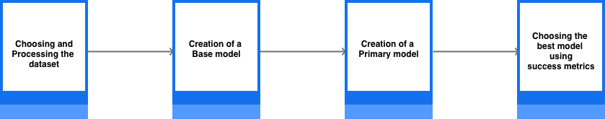
Architecture
Architecture:
Choosing and cleaning/processing the dataset.
Creation of base models using Machine learning libraries such as sklearn.
Creation of a primary model using pySpark machine learning tools based on base models performances.
Choosing the best model based on the success metrics chosen.
Praveen

Slide 7
Methods
Methods:
Step 1 - Data Preprocessing
The Data Preprocessing has two stages.
The first stage consists of reading the yelp dataset which has 8.6M records as chunks, selecting the necessary features for the creation of the model and storing those chunks individually.
The second data processing stage has multiple steps such as lower case conversion, removal of punctuations, removal of stop words, lemmatization and labelling.
Praveen

Slide 8
Data Processing
Data Processing Contd. #1
Lower case conversion
Conversion of the text into lower case in order to avoid the computer treating the same words written in different cases as different entities.
Removal of punctuations
Removing the punctuations in order to get rid of the computer treating the same words with different punctuations as different entities.
Removal of stop words
Stop words are a collection of words that do not add much meaning to the sentences but occur frequently in a language.
Praveen

Slide 9
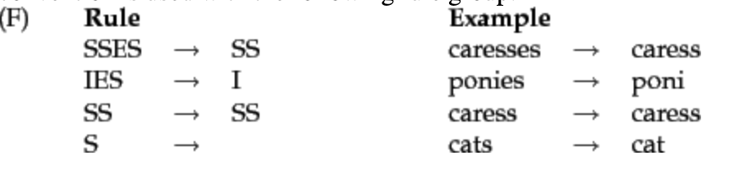
Data Processing
Data Processing Contd. #1
4. Lemmatization - nltk, pattern
Lemmatization is the process of reducing a word into its root word normally aiming to remove inflectional endings only and to return the base or dictionary form of a word.
Praveen

Slide 10
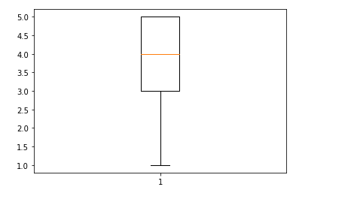
Data Processing
Data Processing Contd. #2
5. Labelling
We have labeled each review based on the number of stars associated with that review. In order to understand the threshold based on which we can divide the positive and negative reviews
Praveen

Slide 11


Base Model
Step 2 : Baseline Model Creation
Creation of a baseline model helps us in understanding our data which is very helpful for developing our primary model. We have created the baseline models using the machine learning libraries such as sklearn, numpy etc. We have implemented two modes in our baseline model:
Fig 1. Logistic Regression
Fig 2. Decision Tree
Navya

Slide 12
Primary Model
Step 3: Primary Model Creation
Based on the previously created baseline models we have chosen to implement logistic regression using the pyspark.ml as our primary model.
Creating schema and loading data into spark cluster.
Balancing positive and negative review
Tokenizations and count Vectorization
Training the dataset using Logistic Regression and SVM
Finding the accuracy by both the models.
Step 4 - Choosing the best model using success metrics
We have chosen the test accuracy of the model as a success metric. The results and the best model accuracy will be discussed in the results section.
Navya

Slide 13
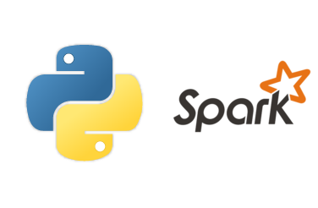





Tools Used
Big Data Tools Used
Bhavana

Slide 14
Results
Results :
The below table summarizes the outcomes of all the models created -
Model | Training Accuracy | Test Accuracy | F1-score
Base Mode 1 (Logistic Regression) | 0.8271 | 0.8280 | 0.8274
Base Mode 2 (Decision Tree) | 0.9988 | 0.7331 | 0.7332
Primary Model 1 (logistic regression) | 0.9469 | 0.8913 | 0.9179
Bhavana

Slide 15
Lessons Learnt
Lessons Learnt:
One should be vigilant while installing spark in a python environment since it requires a lot of installations.
Errors faced in the process of developing the project are time taking and not easy to understand.
Overfitting a model leads to wrong predictions. ​
Sometimes, simpler machine learning models such as logistic regression works better for classification than the higher level machine learning models such as decision trees.
Bhavana

Slide 16
Code
##Code in Action##
Bhavana

Slide 17
Thank You
Thank you
Bhavana

